Slide 1
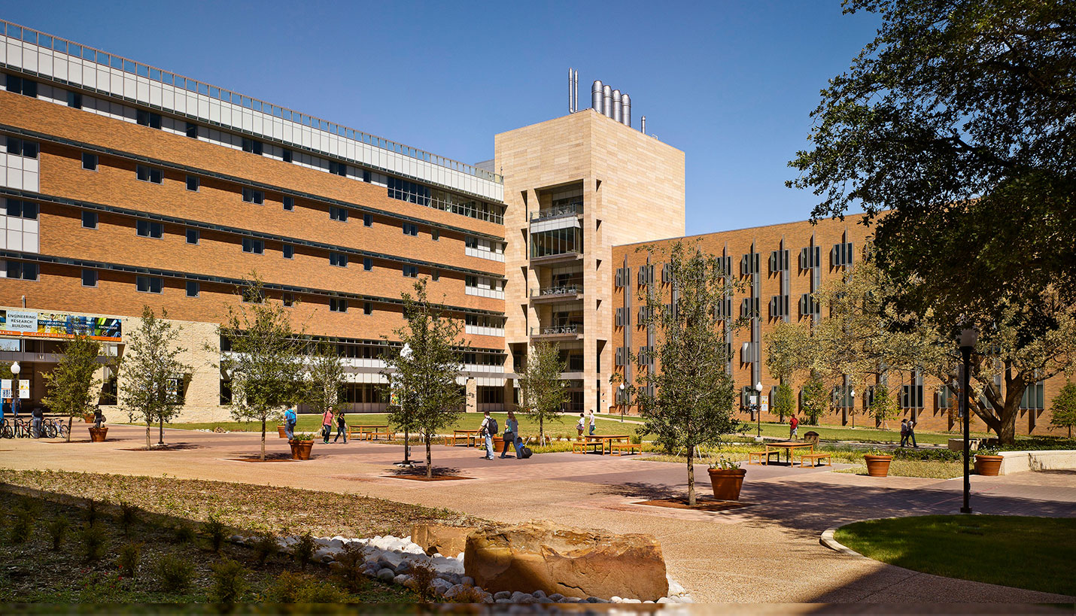
Development of Text Analytics for Debriefing Reflection Essays
Md Shadekur Rahman
Department of Computer Science and Engineering
University of Texas at Arlington
MS thesis defense
Committee:
Deokgun Park (Adviser)
Shirin Nilizadeh
Leonidas Fegaras
Yan Xiao

Slide 2
Background System Architecture Literature Review, Methodology Experimental results Findings, Future Research
References
Presentation Outline

Slide 3

Background
01
02
Teaching an online course with large enrollment
Students submit Free open-ended text assignment

Slide 4
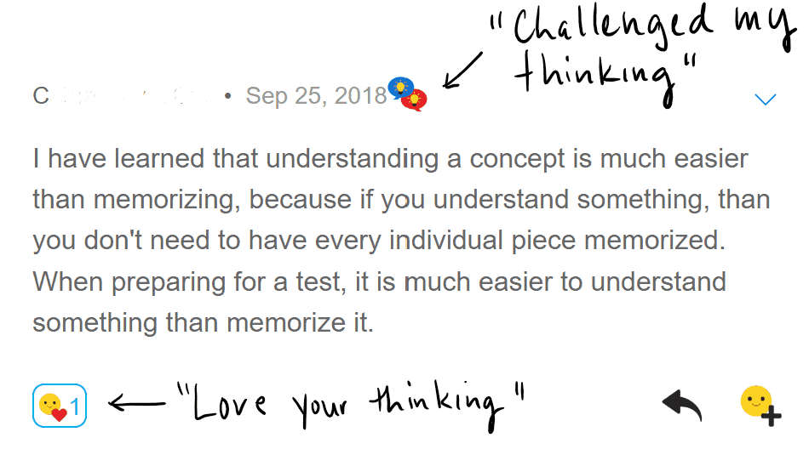
Background
03
Provide effective feedback to students

Slide 5
Research Question
04
Objective
How to identify themes or concepts in essays and suggest feedback
Build a full-fledged text analytics system to find out themes present in the text and provide customized feedback to students

Slide 6
Theme examples: Psychological safety
Learning
Culture in a unit
Humility
Not blaming culture
Administrative leadership
Curiosity
Learning root causes of problems
Encouraging questioning, not feeling in trouble for asking questions
“No dumb questions”
Daily conversation, open communication
Positive, inviting environment, draw people in
Everybody is important, equally valuable
Examples of own mistakes in the past
Sharing the common fear to speak up
Sharing the anxiety of being dumb when speaking with providers
Just culture
No retaliation
Modeled and demonstrated by leaders
Leadership support
Personal relationships
Policy for speaking up
Demonstrate positive culture

Slide 7
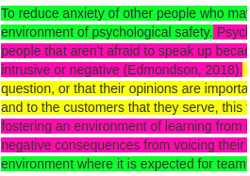
System Overview
Coaches/ Instructors
Students
EssayIQ
…
Assignments (e.g reflection essays)
Feedbacks on Assignments

Slide 8
System Architecture
Coaches/ Instructors
1. Initial development: building themes for assignment perspectives
2. Refinement of theme sentences
Initial theme phrases and sentences
Perspective present and absent
Essays & reflections to be reviewed
1. Identifying additional sentences related to the themes (using theme annotation process)
2. theme sentences on perspectives for assignment
…
3. Parsing each essay and highlighting sentences with color codes for targeted perspectives
Feedbacks on essays & reflections
EssayIQ

Slide 9
Literature review
Word2vec
Maps word to vector according to Contextual Similarity
Conceptvector
Custom concept building option using word embedding
Word2vec for phrase
Build word2vec model not just based on single words, but also combining n-grams
Universal Sentence Encoder
Developed by Google. Maps words, sentences and short paragraphs to fixed size vector

Slide 10

Methodology for EssayIQ
Phase 1: Choose an essay
Phase 2: Split essay into sentences
Essay sentence 1
Essay sentence 2
Essay sentence 3
Essay sentence n

Slide 11
Common methodology for Phrase2vec and USE
:
Split essay into sentences
Phase 3: Minimal set of candidate theme sentences
Phase 4: Highlight essay sentences with theme color code
Essay sentence 1
Essay sentence 2
Essay sentence 3
Essay sentence n
Essay sentence 1
Essay sentence 2
Essay sentence 3
Essay sentence 4
Essay sentence n
Theme 1 Sentence 1
Theme 1 Sentence 2
Theme 1 sentence n1
Theme 2 Sentence 1
Theme 2 Sentence 2
Theme 2 sentence n2

Slide 12
Sentence representation
Converted into an embedding vector of fixed size
Example: I believe that the most important factor is to create a safe environment first.
Embedding: [0.01554, -0.0549, 0.0062, ...]
- Embedding size varies. For Phrase2vec it is 50, and for Universal Sentence Encoder it is 512.

Slide 13
EssayIQ sentence comparison models
Two models
Word2vec for Phrases (shortly Phrase2vec)
Universal Sentence Encoder (USE)

Slide 14
Steps in building Phrase2Vec model
Phase 1
Phase 2
Phase 3
Phase 4
Transform wiki sentence data into bigram-wiki data using Phraser method.
The process involves lemmatization of words and tokenization of sentences.
Transformation will add some 2-gram terms in the vocabulary
In similar way, transform bigram-wiki data into trigram data.
Will add some 3-gram terms in the vocabulary
Transform trigram sentence data into 4-gram wiki data.
Save 4-gram Phraser model and load it later.
Will add some 4-grams in the vocabulary
Build word2vec model using 4-gram wiki data.
As a result, each vocabulary term is represented as a vector with size 50.

Slide 15
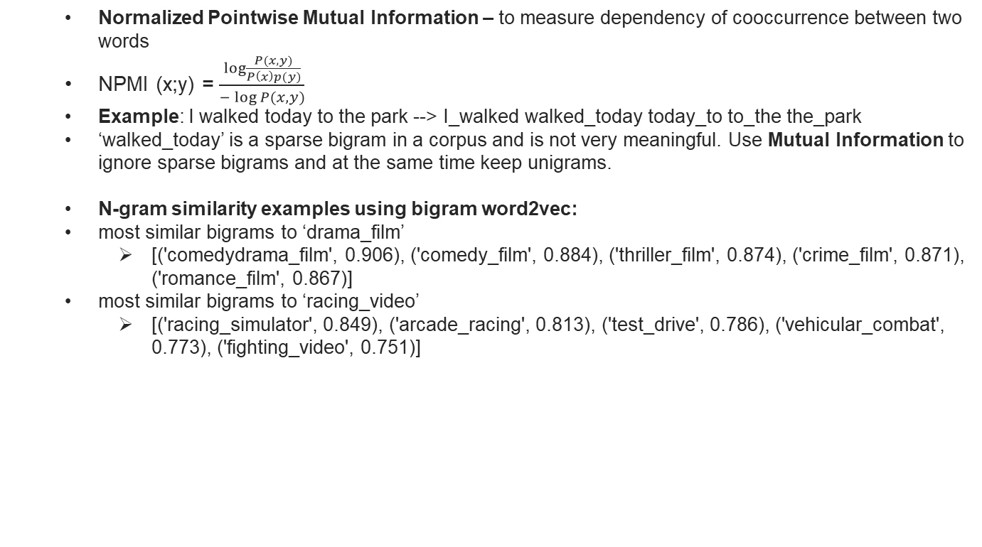
Concepts of Phraser method
Normalized Pointwise Mutual Information – to measure dependency of cooccurrence between two words
NPMI (x;y) = $\frac{\log{\frac{P(x,y)}{P\left(x\right)p(y)}}}{−\log{P(x,y)}}$
Example: I walked today to the park --> I_walked walked_today today_to to_the the_park
‘walked_today’ is a sparse bigram in a corpus and is not very meaningful. Use Mutual Information to ignore sparse bigrams and at the same time keep unigrams.
N-gram similarity examples using bigram word2vec:
most similar bigrams to ‘drama_film’
[('comedydrama_film', 0.906), ('comedy_film', 0.884), ('thriller_film', 0.874), ('crime_film', 0.871), ('romance_film', 0.867)]
most similar bigrams to ‘racing_video’
[('racing_simulator', 0.849), ('arcade_racing', 0.813), ('test_drive', 0.786), ('vehicular_combat', 0.773), ('fighting_video', 0.751)]

Slide 16
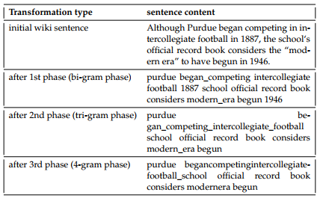
Phrase2vec: example of sentence transformation

Slide 17
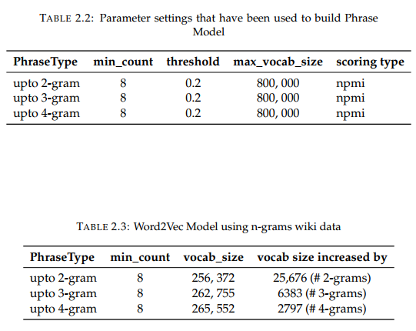
Phrase2vec: parameter settings and vocabulary stats

Slide 18
Phrase2vec: sentence to embedding
Build embedding from sentence
4-gram Phraser model converts each essay sentence or theme sentence into a 4-gram sentence.
4-gram sentence is tokenized and lemmatized to get embedding vector for each n-gram present in the sentence.
All the n-gram embedding vectors are averaged to create Phrase2vec sentence embedding.

Slide 19
Universal Sentence Encoder (USE) model
You need to show all of the following within your methods:
Steps in using trained USE model
Load latest trained Universal Sentence Encoder model in EssayIQ system.
Pass an essay sentence or a theme sentence as parameter to get an embedding with size 512.

Slide 20
Sentence distance measure
EssayIQ system uses both Phrase2vec and USE model independently.
In both models, pair-wise sentence distance is measured by cosine distance between embedding vectors of that pair.
In the experiments, we use several threshold values (0.5-0.8) to define sentence similarity. Pairwise distance values lower than the threshold are meant to define semantic similar sentence pairs.

Slide 21
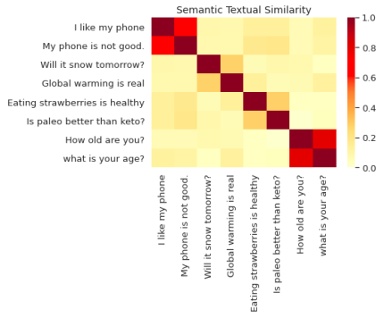
USE model: Semantic Similarity plot

Slide 22
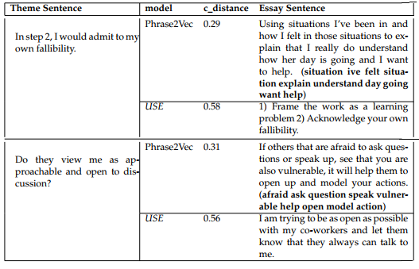
Semantic Similarity examples from assignment data

Slide 23
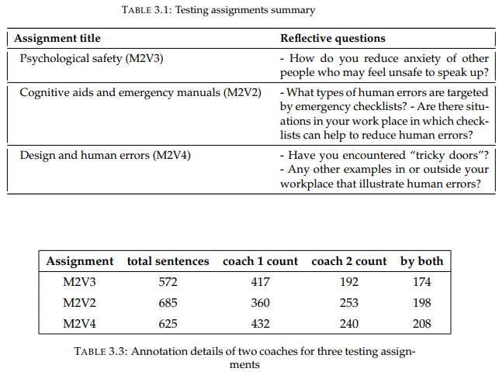
Dataset: Testing assignments and annotations

Slide 24
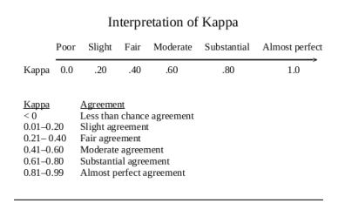

Cohen’s Kappa interpretation
Kappa, K $=\frac{Po −Pe}{1 −Pe}$
Po = observed agreement,
Pe = expected agreement

Slide 25
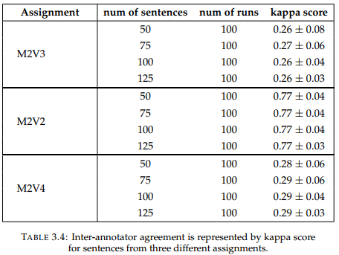
Inter-coach assignment annotation agreement

Slide 26
Research Objectives
Objective #1 Build a text analytics system, EssayIQ
Objective #2 Test EssayIQ to quantify how much it fares with human performance regarding “Theme identification”

Slide 27
Research findings
01
Observation #1 Universal Sentence Encoder model performs better than Phrase2vec model
02
Observation #2 The more human-human agrees regarding annotation, the more EssayIQ-human agrees.

Slide 28
EssayIQ evaluation process
Step 01 Set assignment name, human annotator, theme sentence size, distance threshold
Step 03 Compare EssayIQ theme prediction with that of human annotation using Cohen’s kappa
01
03
01
02
04
Step 02 Run EssayIQ Assignment highlighting api for both Phrase2vec and USE separately
Step 04 Go back to step 01 to run Assignment highlighting with a different params setting

Slide 29
Kappa agreement on Sentence level
In this approach, all assignment sentences are scanned to see how many sentences are labelled and which theme is predicted for each sentence by both EssayIQ and human.

Slide 30
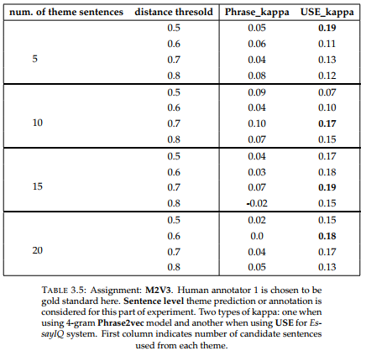
M2V3: Sentence level kappa

Slide 31
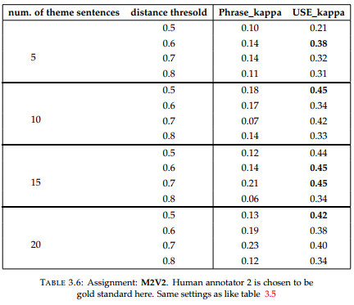
M2V2: Sentence level kappa

Slide 32
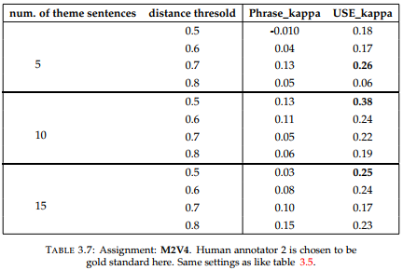
M2V4: Sentence level kappa

Slide 33
Kappa agreement on Essay level: unweighted and weighted
In this approach, predicted or annotated themes are searched on essay level, not on sentence level. Example below for an essay with two sentences:
EssayIQ prediction
Human annotation
Sentence 1, Sentence 2, Sentence 3
Sentence 1, Sentence 2, Sentence 3

Slide 34
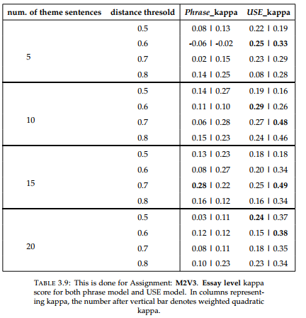
M2V3: Essay level kappa

Slide 35
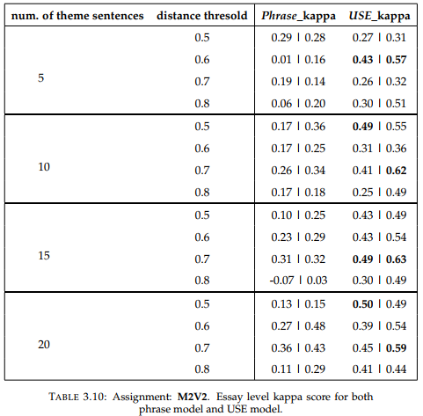
M2V2: Essay level kappa

Slide 36
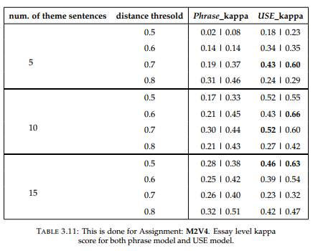
M2V4: Essay level kappa

Slide 37
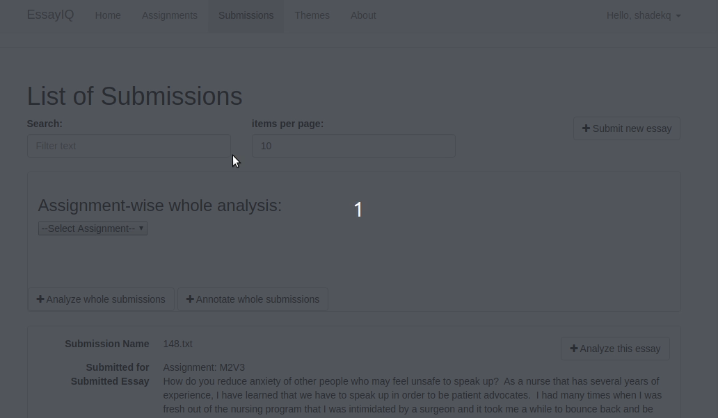
Essay analysis demo

Slide 38
Conclusions / Findings
Research Question: how to build text analytics system that can identify themes with human level performance
Results show that models that are built on “semantic sentence similarity” performs better than models with “word or phrase level” similarity
Limitations:
only quantitative evaluation was performed
System can not identify multiple themes from a sentence.
Future research: Improve the EssayIQ system to identify clause-based theme identification, multiple theme detection in same clause or sentence. Suggest automatic feedback. Perform Qualitative evaluation.

Slide 39
References
References
Conceptvector www.researchgate.net/publication/319414054_ConceptVector_Text_Visual_Analytics_via_Interactive_Lexicon_Building_Using_Word_Embedding
1
Word2Vec papers.nips.cc/paper/5021-distributed-representations-of-words-and-phrases-and-their-compositionality.pdf
2
3
4
Universal Sentence Encoder arxiv.org/abs/1803.11175
Word2vec for Phrases towardsdatascience.com/word2vec-for-phrases-learning-embeddings-for-more-than-one-word-727b6cf723cf
6
Inter-observer agreement: kappa statistic web2.cs.columbia.edu/~julia/courses/CS6998/Interrater_agreement.Kappa_statistic.pdf
5
Automated Essay Scoring journals.sagepub.com/doi/abs/10.1177/0146621605278217?journalCode=apma

Slide 40
QUESTIONS

Slide 41
Acknowledgement
- Thanks to my advisor, Deokgun park
- Collaborators and committee members: Shirin Nilizadeh, Yan Xiao, Leonidas Fegaras
- Thanks to all HDI lab members for attending.

Slide 42
THANK YOU !
Development of Text Analytics for Debriefing Reflection Essays
Md Shadekur Rahman
Department of Computer Science and Engineering
University of Texas at Arlington
MS thesis defense

